Slide 1


Current Trends in AI Technology: The 2025 Landscape
Welcome to an exploration of the transformative trends shaping Artificial Intelligence in 2025. This presentation delves into the dynamic landscape of AI, highlighting key advancements and their profound implications for businesses and society alike. We will uncover how AI is evolving from a tool to an indispensable partner, driving unprecedented innovation and reshaping industries globally.

Slide 2


Chapter 1
The AI Revolution Accelerates in 2025
The year 2025 marks a pivotal moment in the AI revolution, characterized by an unprecedented acceleration in adoption and sophistication. According to a 2024 report by Microsoft, a staggering 75% of business leaders are now actively integrating Generative AI tools into their operations. This isn't merely about boosting productivity; AI is transcending its role as a simple efficiency enhancer to become a core driver of transformative decision-making and the emergence of truly agentic AI.
Enterprises are increasingly demanding AI solutions that don't just offer incremental improvements but deliver optimized performance, robust security, and clear, measurable returns on investment. This shift signifies a maturation of AI technologies, as organizations move beyond experimental phases to strategic, impactful deployments. The race is on to leverage AI for competitive advantage, driving innovation across every sector.
Key Takeaway:
AI is no longer a niche technology; it's a mainstream strategic imperative for businesses seeking to innovate, optimize, and secure their future.

Slide 3

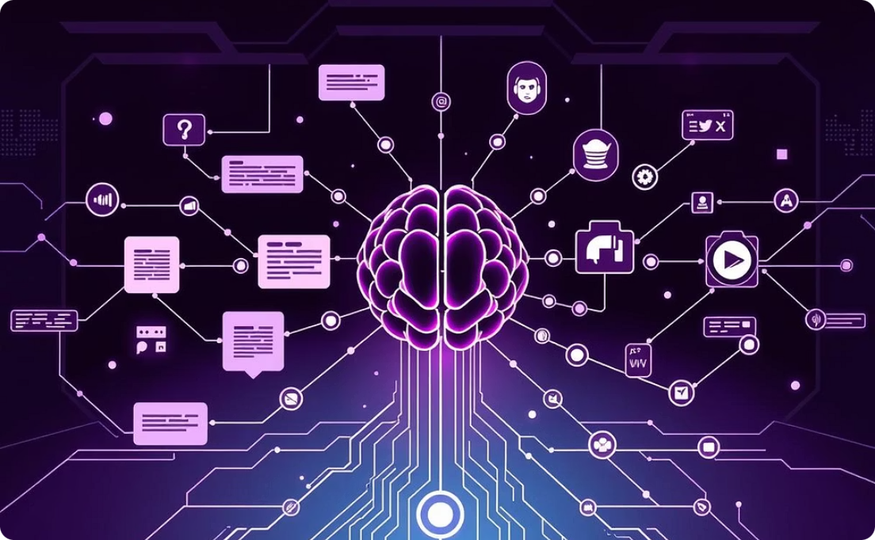
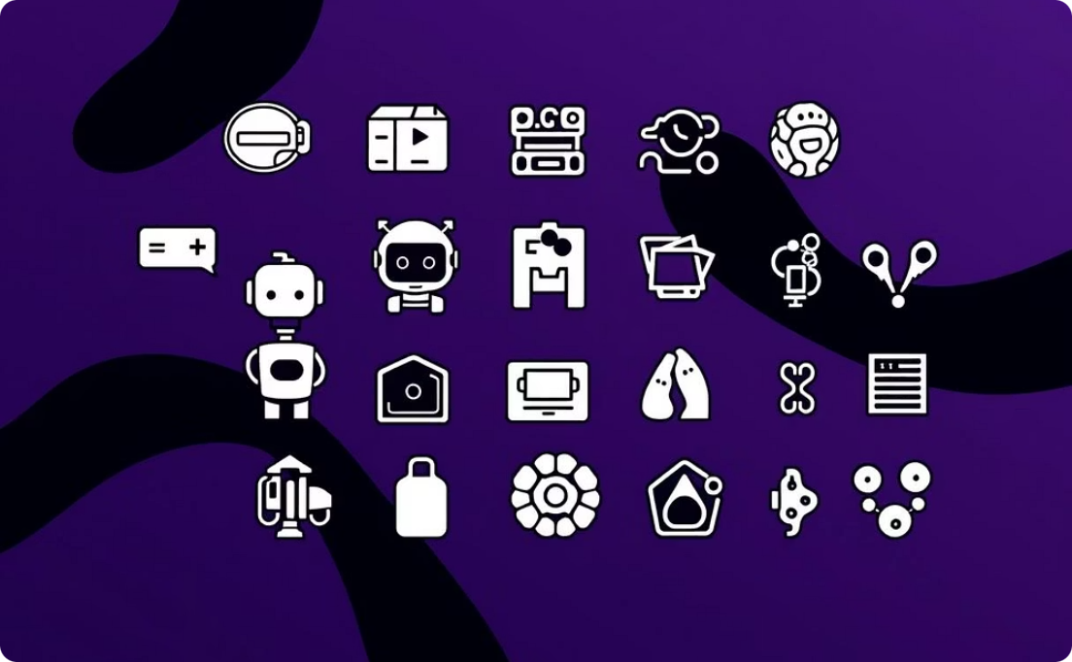
Chapter 2
Generative AI: From Novelty to Mainstream Powerhouse
LLMs: Unprecedented Processing Power
Multimodal AI: Richer Insights & Applications
Diverse & Impactful Use Cases
Large Language Models (LLMs) have evolved dramatically, now capable of processing up to 2 million tokens in a single prompt—the equivalent of reading 20 novels at once, as reported by McKinsey in 2025. This immense capacity unlocks new frontiers for understanding and generating complex, nuanced content, moving beyond basic text completion to sophisticated reasoning and creation.
Generative AI's practical applications are expanding rapidly across industries. We see sophisticated customer service chatbots providing human-like interactions, AI-driven tools generating personalized ad campaigns, accelerated drug discovery processes, and revolutionary approaches to creative content generation, from music composition to scriptwriting. Its versatility makes it an indispensable asset.
The integration of multimodal AI signifies a major leap, allowing systems to seamlessly process and synthesize information from text, images, audio, and video. This convergence leads to richer insights and more holistic applications, from interpreting complex medical scans combined with patient notes to generating dynamic, contextually aware marketing content across various media.

Slide 4

Chapter 3
The Rise of Agentic AI: AI That Acts Autonomously
Agentic AI represents a significant evolution beyond mere AI assistants. These autonomous agents are designed to achieve specific goals and manage complex workflows independently, a trend extensively analyzed by theCUBE Research in 2025. Unlike traditional AI that responds to direct commands, agentic AI can plan, execute, and adapt to achieve its objectives without constant human oversight.
The implications for business processes are profound. AI agents are now handling intricate tasks such as monitoring supply chains for disruptions and autonomously issuing alerts, responding to routine HR queries, and even generating comprehensive reports from disparate data sources. This shift is set to revolutionize not only organizational efficiency but also personal productivity, freeing up human talent for more strategic and creative endeavors. The future workforce will increasingly collaborate with these intelligent, self-directed AI entities.

Slide 5
Chapter 4
AI Reasoning and Custom Silicon: Powering Smarter AI
Cognitive Leap: AI Reasoning
Performance Boost: Custom Silicon
Ubiquitous Intelligence: Edge AI
AI is developing the ability to reason through problems much like humans, moving beyond pattern recognition to complex logical inference. This advancement, highlighted by Morgan Stanley in 2025, is profoundly impacting fields requiring deep analytical thought.
The demand for specialized hardware is accelerating. Custom-designed chips, known as Application-Specific Integrated Circuits (ASICs), are surpassing general-purpose GPUs in efficiency and speed for AI workloads.
Edge AI, processing data closer to its source, is gaining traction, necessitating specialized silicon. These chips enable real-time inference on small devices, from smart sensors to autonomous vehicles.
Law: AI assists in case analysis and legal research.
Optimized Performance: ASICs are tailored for specific AI algorithms, leading to significant performance gains.
Low Latency: Critical for applications requiring immediate responses.
Medicine: AI supports diagnostics and treatment planning.
Enhanced Privacy: Data processing happens locally, reducing the need to send sensitive information to the cloud.
Energy Efficiency: They consume less power, crucial for sustainable AI operations and edge devices.
Coding: AI helps in debugging, optimizing code, and even generating entire software modules.

Slide 6
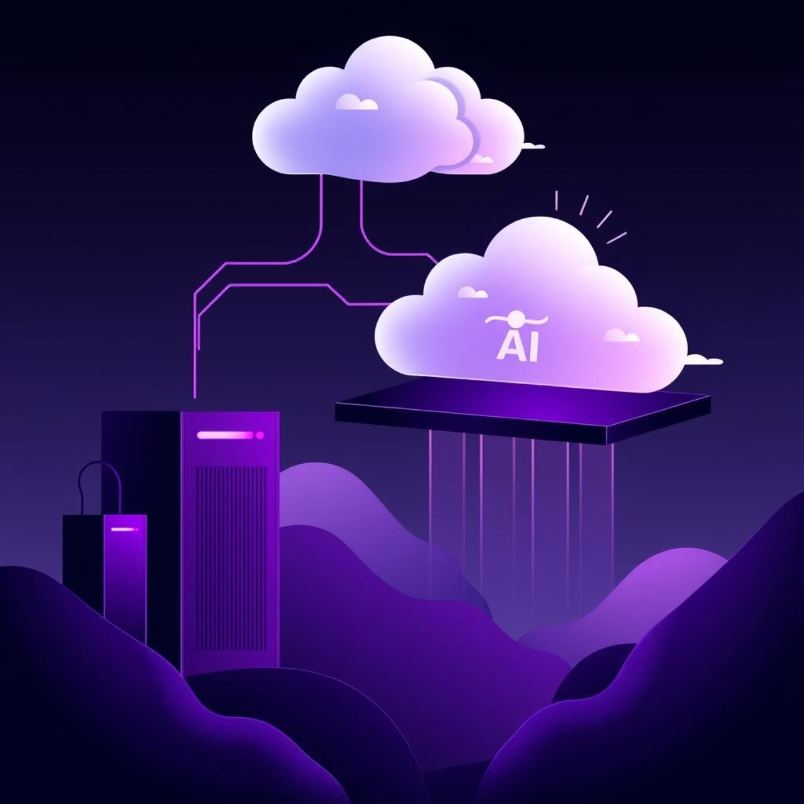
Chapter 5
Cloud Migrations & AI Workloads: Hyperscalers Lead the Charge
Major cloud providers, often referred to as hyperscalers, are at the forefront of capitalizing on the explosive demand for AI. They are strategically migrating vast enterprise workloads to their AI-optimized cloud infrastructures, offering unparalleled scalability and computational power. This transition is not just about storage; it's about providing integrated environments where AI can thrive.
These cloud AI platforms go beyond mere compute resources. They offer a comprehensive ecosystem that integrates frontier models (the latest and most advanced AI models), robust data pipelines, and development tools. This integration simplifies the deployment of scalable AI solutions for businesses of all sizes, significantly lowering the barriers to entry for advanced AI adoption. The result is faster innovation cycles, as companies can leverage cutting-edge AI without the prohibitive upfront costs or the complexities of managing on-premise infrastructure. This democratizes AI, allowing more businesses to harness its transformative power.
Scalability: On-demand resources for fluctuating AI needs.
Accessibility: Access to advanced models and tools without heavy investment.
Integration: Seamless workflow with existing cloud services.
Innovation: Rapid prototyping and deployment of new AI applications.

Slide 7
Chapter 6
Explainable and Ethical AI: Building Trust in AI Systems
The Imperative of Transparency
Evolving Regulatory Landscape
Ethical AI as a Differentiator
Beyond compliance, embracing ethical AI development is emerging as a powerful competitive differentiator. Companies that prioritize fairness, accountability, and transparency in their AI systems build stronger brand loyalty and attract top talent committed to positive technological impact.
As AI increasingly influences high-stakes decisions—from loan approvals to medical diagnoses—transparency and explainability have become critical. Organizations, as noted by Cloudwave Inc. in 2025, must be able to articulate how AI models arrive at their conclusions, fostering trust and accountability.
Globally, governments and regulatory bodies are actively developing frameworks to ensure responsible AI use and protect data privacy. These regulations aim to mitigate risks such as algorithmic bias, misuse of personal data, and the societal impact of widespread AI deployment. Compliance is becoming a non-negotiable aspect of AI adoption.

Slide 8

Chapter 7
AI in Cybersecurity and Business Growth
AI Fortifies Cybersecurity
In an era of escalating cyber threats, AI has become an indispensable ally. AI-driven cybersecurity solutions offer the ability to detect and respond to attacks in real time, far exceeding human capabilities. These systems learn from vast datasets of threats, identifying anomalous behavior, zero-day exploits, and sophisticated phishing attempts before they can inflict significant damage. This proactive defense is critical for protecting sensitive data and maintaining operational continuity against increasingly cunning adversaries.
AI Fuels Business Growth
Beyond defense, AI is a powerful engine for business growth. AI-powered personalization and recommendation systems are revolutionizing e-commerce and marketing, driving higher conversion rates and customer satisfaction. By understanding individual preferences and behaviors, AI can tailor product offerings, content, and advertising, leading to increased engagement and a stronger return on investment. Furthermore, the emergence of AI-native applications—software designed from the ground up with AI at its core—is reshaping industries, offering innovative solutions and creating entirely new market opportunities.

Slide 9



Chapter 8
Emerging Technologies Complementing AI
Quantum Computing
5G Expansion
VR/AR and Robotics
While still nascent, quantum computing holds immense potential to supercharge AI in specific domains. As Simplilearn noted in 2025, its ability to solve complex computations far beyond classical computers will accelerate AI advancements in cryptography, drug discovery through molecular simulation, and optimizing vast datasets for machine learning.
The ongoing global expansion of 5G networks provides the foundational connectivity for next-generation AI applications. Its faster speeds and ultra-low latency are critical for real-time AI in edge devices, enabling autonomous vehicles to make instantaneous decisions and powering sophisticated IoT ecosystems with distributed AI intelligence.
Advances in Virtual Reality (VR), Augmented Reality (AR), and robotics are increasingly intertwined with AI. AI provides the intelligence for immersive experiences in VR/AR, creating realistic digital twins and responsive virtual environments. In robotics, AI powers perception, navigation, and decision-making, leading to more autonomous and intelligent robotic systems in manufacturing, logistics, and service industries.

Slide 10
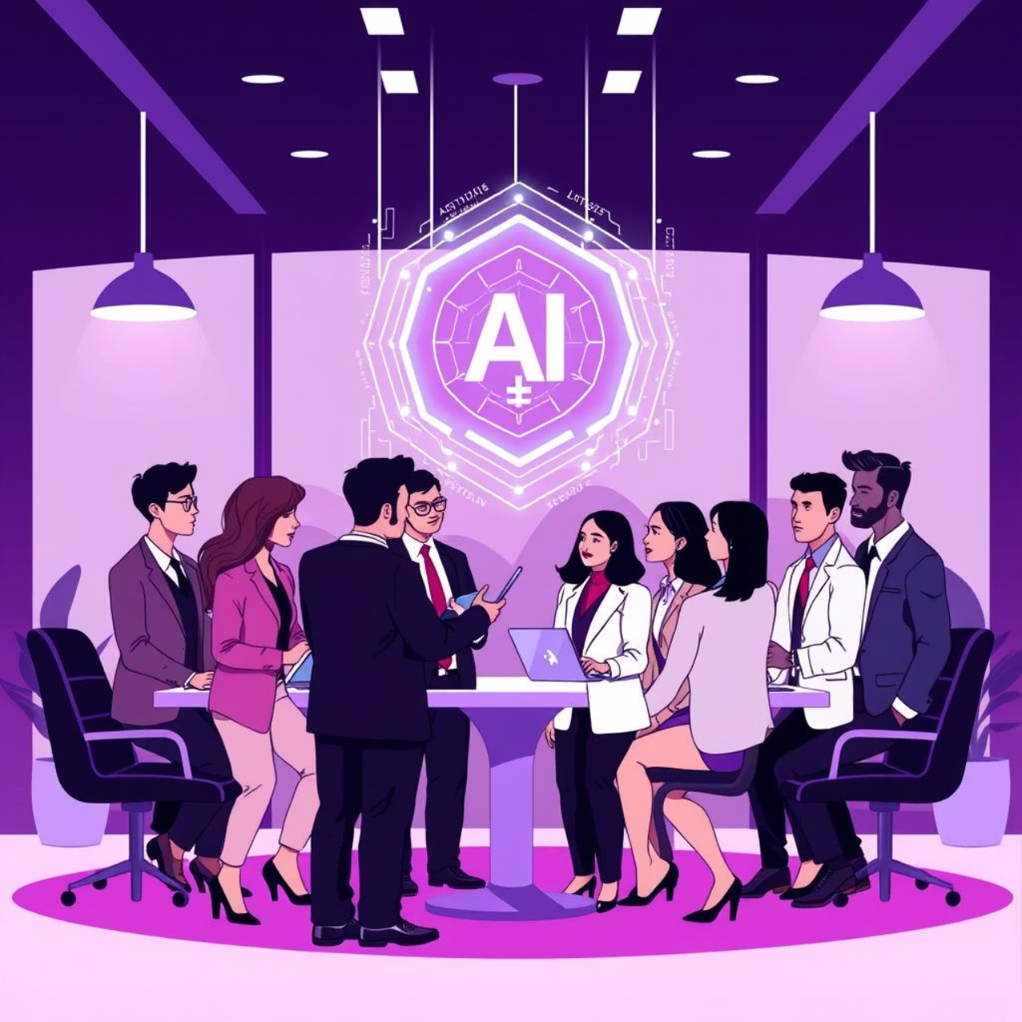
The Future is AI-Driven: Prepare for a New Era
As we've explored, AI is no longer a peripheral tool; it has profoundly integrated itself as an integral partner in both work and daily life, a sentiment echoed by Microsoft in 2025. This new era demands a proactive approach from businesses and individuals alike.
To thrive in this AI-driven future, businesses must invest strategically in several key areas:
AI Talent: Cultivating and attracting individuals with AI expertise is paramount.
Infrastructure: Building robust, scalable AI infrastructures, whether on-premise or in the cloud, is essential.
Ethical Frameworks: Implementing clear ethical guidelines and governance for AI use ensures responsible and trustworthy development.
The AI frontier promises unprecedented levels of innovation, productivity, and societal impact. From personalized experiences to solving complex global challenges, the potential is boundless. The time to act is now, not merely to keep pace, but to lead the charge into this transformative new chapter.

